Slide 1

Starter:
Read the following statements from Hitler –
Pick out 5 descriptions that suggest he, and the Nazis, valued the youth of Germany.
“I am beginning with the young. We older ones are used up…we are weak and carry the burden of the past…But my magnificent youngsters – you are the future…you are the men and women of the 1000 year Reich! What material! With them I can make a new world.” – 1933.
"The weak must be chiselled away. I want young men and women who can suffer pain. A young German must be as swift as a greyhound, as tough as leather, and as hard as Krupp's steel." – 1934.

Slide 2
Dieter – Son.
Dieter is 11 years old.
He enjoys going to school and has many Jewish friends that attend the primary school he goes to.
Dieter’s other passion is sport and outdoor pursuits. If Dieter is not camping he can usually be found kicking a football around with his mates in his neighbourhood.
Dieter is too young to be interested in the political views of the Nazis but has heard Hitler speak on the radio and has often marvelled at the applause his speeches seem to get.
Ansel, Dieter’s father, has often told him that the Nazis don’t have all the answers to Germany’s problems but Ansel is too young to really take much notice of his father.
Dieter has seen a number of Nazi parades and has always been amazed by the colour and scale of processions – in particular the 1927 Nuremberg Rally. In addition the Nazi Brown Shirts – SA - have always seemed to be strong, orderly but friendly.
Dieter has a red Swastika armband that an SA man gave to him during a march through Dieter’s town. He has not told his father about the armband but he treasures it dearly.
A few of Dieter’s friends have joined the Hitler Youth and constantly talk about the camping trips they go on. Dieter’s father will not let him join the Hitler Youth.

Slide 3

Starter – Dieter – the son. Last week we looked at Dieter (his character card is on the back of the sheet but can you fill in this grid for us please.
Things that suggest he may join the Nazi youth
Things that suggest he won’t join the Nazi Youth.

Slide 4
A date for your diary
Monday 16th July
1530
Venue – tba
A-Level talk

Slide 5
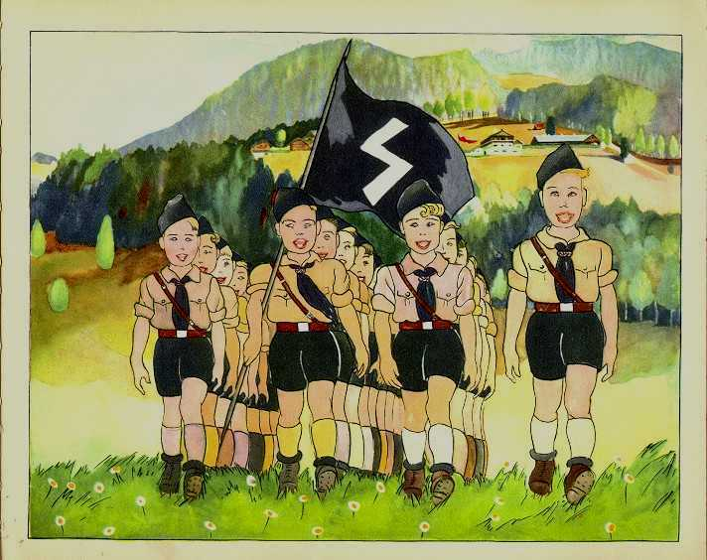
How did the Nazis deal with young people?

Slide 6
Lesson objectives:
To examine the importance of children to Hitler and the Nazis.
To examine the changes that took place under the Nazis for the youth in Germany.
To consider if changes for German children were massive during the 12 years of Nazi rule.

Slide 7

Task 1.
Read page 167 in the Ben Walsh books.

Slide 8

Newsflash...

Slide 9

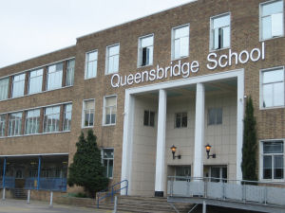


Welcome to Queensbridge under the Nazis.
Nazi school

Slide 10

National Announcement on behalf of the newly created
Department for children, schools and families
The following announcement will be made to all year 10 History GCSE students, throughout England and Wales, on Tuesday 10th July 2007 by order of Her Majesty’s Government.
Notes:
The above slide was already projecting against the wall in the darkened classroom as the pupils came in. I had undergone 5 minutes of ‘ham’ acting whilst the students waited in the corridor. At one point, a very flustered Miss J. walked to the door to pull the curtain over the glass. The nosier members hurried along the corridor to peer through a second window at me and I could hear comments such as, “What’s going on?” and “She looks worried” from the corridor outside,
My aim here was to alert them, make them think that something was wrong and to change their mentalities before they entered the classroom. This appeared to work as they entered not talking about last nights Eastenders, but keen to know exactly, “what’re doing today Miss”.
The first thing that I did was to apologise that this announcement was 2mins late telling them that the precise time had past as I had not been able to operate the Light Pro properly. I asked if the could please not mention my mistake to anyone. The result of this was a picture, a sea of confused faces.

Slide 11
Success of Current
Education Policy
As you might be aware, the proper education of all children has become a key component of the brilliant success of the present Government.
No other Government in the history of the world has managed to perfect the instruction of it’s youth. New PM, Gordon Brown, wants to take things even further.
We are now in the final stages of our 10 year plan. As promised in our manifesto, the NC will be changed as follows:
Notes:
I did not spend a long time on this slide. I just used it to explain that the changes to the National Curriculum were to be far reaching and would have an enormous impact on everyone in the room, “This is properly the most important announcement that you will every listen to in your whole life”.

Slide 12
Changes to the School Day
School will, from July 11th 2007, begin at 8am sharp.
All children throughout England will begin the day with one hour of keep fit. Under the instruction of Herrs White and Hall.
Boys can choose from Boxing, Football, Running or Rugby.
Girls must do Music and Movement.
Notes:
Lots of groans from this slide. I kept emphasising that this was the same for ALL students in England & Wales.
A few laughed at the girls for having to do Music and Movement but on the whole not as much laughter as I expected with either class.

Slide 13
New Subjects - Boys
Each school must buy a farm or similar agricultural premises. QB has secured the rights to Highbury Park and will be converting it for agricultural use asap.
Each school must offer NVQs, GCSEs and BTECs in Agricultural Sciences. (farming). Leading on this will be Herr Gardner.
These qualifications will only be open, naturally, to boys.
Notes:
When the farm bullet flew across it was warmly welcomed until I added that the farm that their school was looking to buy was 5 miles out of town and no transport would be provided as it was felt that it would be good for them to jog back to school, after all there is not much traffic on the road before 7.30am, is there?
The last bullet was greeted contemptuously by a few of the girls but again there was no where near the amount of reaction that one might of expected. Perhaps they expect us to be Nazis.

Slide 14
New Subjects - Girls
Girls will from now on be able to benefit from a range of child care courses. These will be run in conjunction with local colleges.
In addition, all girls must be take the following subjects:
  Needlework.
  Domestic Science (cooking).
  Beauty & Therapy.
Notes:
Reaction to this slide was slightly more vocal. I used it to explain how important it was for girls to learn how to be mothers. They would need all of these skills as the future of our country depended upon their individual success with needle and nappy.
A few boys started to laugh but I did not need to pull them up as Shelly, a big girl, shouted out, “Don’t know what your laughing at, you’re gonna be down the farm every morning!”

Slide 15
Removal of Unnecessary Lessons
All modern Languages, other than English. French certainly is a redundant language.
ICT. Until we are able to protect pupils from the filthy lies on the Internet, ICT lessons are suspended. Herrs Thacker, Morris and Cotterill are currently under house arrest, and will be dealt with appropriately in the coming days.
History. Recent OFSTED visits have confirmed that History is being mistaught in secondary schools. History will now be replaced by Heritage. This subject will explore Britain’s glorious past, present & future. Herrs Lee and Alan have kept their jobs – but only just. They are to be monitored closely.
Notes:
A cheer at the welcome news that History was going!

Slide 16
Religion - New Guidelines
R.E. will no longer be taught in Secondary Schools. This subject will be replaced by a daily 1 hour Protestant Service.
Students belonging to all other faiths must use school books with red covers as opposed to those with green ones.
Pupils suspecting their friends of believing in any Mock Religion must report them to the school authorities.
Notes:
At this point I was beginning to wonder how they could be so gullible. It was all getting slightly unnerving.
One pupil, in the first class, got very angry about this, “Say if you’re a Muslim or a Catholic?”, she demanded. I told her that she should take this up with the ‘authorities’ and that I could not possibly give her any sort of answer to her question now.
The second class, let this slide pass them by unnoticed, except for wanting to know what would happen to pupils that were reported.

Slide 17
Inappropriate Use of Uniform
It is an insult to your country to be seen with school uniform in disarray. You must never walk around school with your coat on [ Aquib ]. You must never wear non-school jumpers [ Isaac ]. Children are forbidden from piercing their bodies [ Aiden ]. Chewing gum is an offence that will require you to be excluded from school.
Any child seen with their polo shirt hanging out of their trousers or their trainers on (unless in PE) must be reported by his/her classmates.
All deviant children will enter a two year correction programme. Here they will have their dignity and pride restored painlessly. There will be no lounging around in withdrawal anymore. Following his impending retirement Herr Carriban is to over see this area.
Notes:
Oh what larks Pip!
The school was the scruffiest in the Western World! Pupils competed with each other to see how well they could violate the school uniform. Mud was favourite, splashed as high up their black trousers as they could manage. Ties could be folded so as to look as if they had been cut off mid dangle, they could also be pushed askew or worn at the back.
Instead of laughing at this slide they got ‘Sassy’. Perhaps this new emotion helped me as they did not suspect that there was anything, in the slightest, unusual about any of the above bullets. This was just another example of how bloody-minded grown-ups and, in particular teachers, could be.

Slide 18
Noses
All school children, throughout England must have their noses measured.
Anyone with a nose more than 5cm long (girls) or 6.5cm long (boys) must present themselves to the Racial Purity Board for a painless DNA check.
This may or may not be accompanied by a vitamin injection.
Notes:
AND FINALLY the penny dropped! (With an resounding BANG!)
The biggest mistake that I made with the first group was that I underestimated the impact of this last slide. As soon as the first bullet flew across the screen someone shouted, “It is a joke!” and the whole class erupted. When I say erupt, I mean Etna style! I had an amazingly difficult time attempting to bring them back down to earth.
With the second class, forewarned was definitely forearmed. I did not try to interrupt their laughter but just waited quietly at the front until they had got it all out of their system. I think that another way that I could of lessened the impact of this final slide would have been to played the whole thing less, ‘straight’. If they had only half believed, instead of being four-fifths of the way there, then this last slide would have only been funny.
When they had calmed down I asked them if they could now explain my joke and, after viewing the final slide, we went back through the slide show relating each point to Nazi Germany. The second viewing of ‘Noses’ was far more sober as I had, this time, a picture to show them. A photo of a very worried man having his nose measured so as to check his ethnicity.

Slide 19

Remember, you belong to your country, your school and you must always act as an ambassador. Serve your Motherland well!
God Bless. May the British reign supreme for one thousand years!
Notes:
I clicked onto this last slide and waited for the laughter to subside. On the first occasion it didn’t really calm down until the bell. On the second lesson, once it was calm enough for me to read it, I asked, “ever heard of the thousand year Reich?” This question allowed a little time to slow things down before we moved on to review the slides.
PS: I hope that spelling Mike Tomlinson’s name incorrectly is enough to get past any legal probs.
Doc by Sarah Jewers
Downloaded from www.SchoolHistory.co.uk

Slide 20
Task 2
You are to be tasked with designing a timetable for Dieter.
You must include a whole range of subjects and not leave some out.
I would then like an explanation as to why your timetable is like it is. For example why have you given one subject (maybe PE) twice as much time as another subject.
You must justify your choices.

Slide 21
Dieter’s new QB timetable.
 | Monday | Tuesday | Wednesday | Thursday | Friday
Period 1 8am – 9am
Period 2 9am – 10am
Period 3 10am – 11am
Period 4 11:30 – 12:30
Period 5 12:30 – 1:30
Period 6 2:30 – 4:30pm
Period 7 4:30 – 6:30pm
Note: some periods are double period = 2hours.
1) Which subject/s have you given most time to? Why?
2) What role does your timetable prepare Dieter for? How does it do this?
3) Why do you think the Nazis changed the school timetable so significantly?
Subjects to be included:
German – lang – lit.
Geography.
History.
Race studies and Nazi ideology.
Sports and military parade practice.
Maths.
Domestic science(girls) – extra maths (boys)
Eugenics and biology.
English.

Slide 22
Dieter’s new QB timetable.
 | Monday | Tuesday | Wednesday | Thursday | Friday
Period 1 8am – 9am | PE | PE | PE | PE | PE
Period 2 9am – 10am | maths | Geography. | History. | History. | Race studies and ideology.
Period 3 10am – 11am | Geography. | Eugenics and biology | maths | Eugenics and biology | Eugenics and biology
Period 4 11:30 – 12:30 | Race studies and ideology. | Sports and military parade. | Sports and military parade. | Geography. | maths
Period 5 12:30 – 1:30 | Eugenics and biology | English | English | Eugenics and biology | English
Period 6 2:30 – 4:30pm | History. | Race studies and ideology. | Race studies and ideology. | maths | History.
Period 7 4:30 – 6:30pm | Sports and military parade. | English | maths | English | Sports and military parade.
Note: some periods are double period = 2hours.
1) Which subject/s have you given most time to? Why?
2) What role does your timetable prepare Dieter for? How does it do this?
3) Why do you think the Nazis changed the school timetable so significantly?
Subjects to be included:
German – lang – lit.
Geography.
History.
Race studies and Nazi ideology.
Sports and military parade practice.
Maths.
Domestic science(girls) – extra maths (boys)
Eugenics and biology.
English.

Slide 23
Task 4 – starter.
Below are some typical questions a German child may be asked in his/her lessons.
The Jews are aliens in Germany. In 1933 there were 66,000,000 inhabitants of the German Reich of whom 500,000 were Jews. What is the percentage of aliens in Germany?
To keep a mentally ill person costs approximately 4 marks a day. There are 300,000 mentally ill people in care. How much do these people cost to keep in total? How many marriage loans of 1000 marks could be granted with this money?
A bomber aircraft on take-off carries 12 dozen bombs, each weighing 10 kilos. The aircraft takes off for Warsaw the international centre for Jewry. It bombs the town. On take-off with all bombs on board and a fuel tank containing 100 kilos of fuel, the aircraft weighed about 8 tons. When it returns from the crusade, there are still 230 kilos left. What is the weight of the aircraft when empty?
If a boy is born to an Aryan father (whose parents are both 100% Aryan) and a mother (whose has one parent Aryan – one parent Polish). How pure is the boy? Please give as a percentage.

Slide 24
Your task: - When school had finished – were German children free to do as they wished?
Research – when we go to the computer room I want you to research the various sections about the Hitler youth.
Make extensive notes on the role that girls and boys played in the Nazi Party.

Slide 25
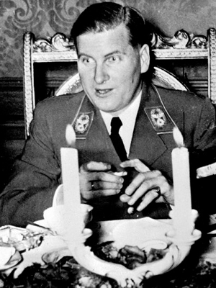
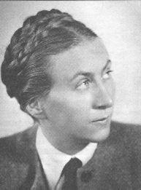
The Hitler youth.
Age | Boys Baldur Von Schirach. | Girls Gurtrud Scholz-klink.
6 – 18 years old | Little fellows – pimpfen. German young folk Hitler Youth. | The Young girls – Jungmadel The league of German Maidens. - BDM

Slide 26
Task 5.
Turn to page 168.
SPR.
Answer questions 2 and 3 at the bottom of the page.

Slide 27
Final Task – hot seating.
You’ve now studied how the Nazis impacted on the lives of young people in Germany.
I want you to come up with 10-15 questions that you can ask Dieter about his life.
Some of you will be selected to come up and be Dieter – others will be asking the questions.
You need to be in a position to play both the character and the questioner because I may select anyone.

